Slide 1
Graph

Slide 2
Graph
A Graph is a set of objects called vertices, together with a collection of pairwise connections between them. The connections are called edges.
A graph is a way of representing relationships that exist between pairs of objects.
Vertices are also called nodes, and edges are also called arcs.

Slide 3
Graph
Edges in a graph are either directed or undirected.
An edge (u, v) is said to be directed if the edge has a direction (from u to v).
An edge (u, v) is said to be undirected if the edge does not have any direction.

Slide 4
Graph
If all edges in a graph are undirected, then the graph is called an undirected graph.
If all edges in a graph are directed, then the graph is called a directed graph (also called digraph)
If a graph has both types of edges, then it’s called a mixed graph.

Slide 5
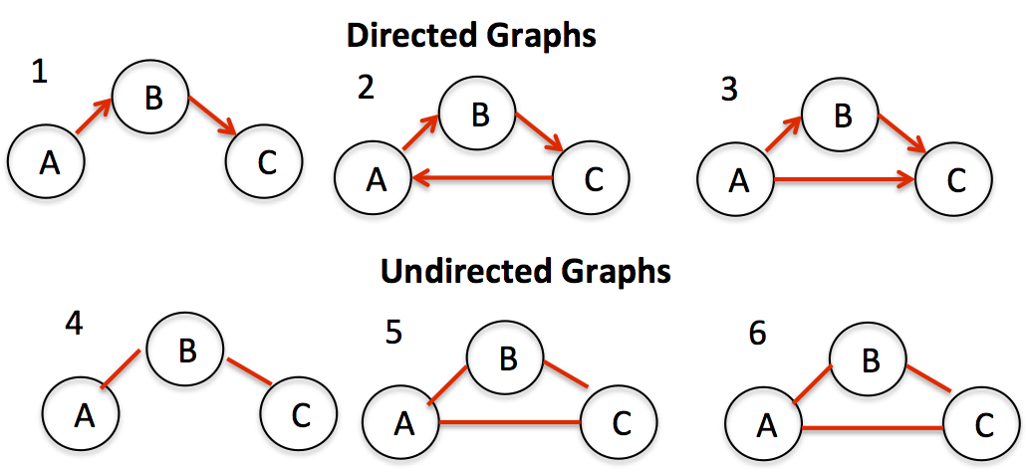
Examples
Notes:
Source: https://sites.google.com/a/cs.christuniversity.in/discrete-mathematics-lectures/graphs/directed-and-undirected-graph

Slide 6
Terms related to Graphs
The two vertices joined by an edge are called the end vertices (or endpoints) of the edge.
If an edge is directed, its first endpoint is its origin and the other is the destination of the edge.
Two vertices u and v are said to be adjacent if there is an edge whose end vertices are u and v.
An edge is said to be incident on a vertex if the vertex is one of the edge’s endpoints.

Slide 7
Terms related to Graphs
The outgoing edges of a vertex are the directed edges whose origin is that vertex.
The incoming edges of a vertex are the directed edges whose destination is that vertex.
The degree of a vertex v, denoted deg(v), is the number of incident edges of v (alternatively, the number of edges in which v is one of the endpoints).
The in-degree and out-degree of a vertex v are the number of the incoming and outgoing edges of v, and are denoted indeg(v) and outdeg(v), respectively. These terms are used for directed graphs.

Slide 8
Terms Related to Graphs
If there are atleast two edges in a graph whose end points are the same, then such edges are called parallel edges or multiple edges.
An edge (undirected or directed) is a self-loop if its two endpoints are the same.

Slide 9
Terms Related to Graphs
If the edges in a graph have weights, then the graph is called the weighted graph.
If edges do not have weight, then the graph is called the unweighted graph.
A weight is a numerical value attached to each individual edge.
In a weighted graph relationships between nodes have a magnitude and this magnitude is important to the relationship we’re studying.
In an unweighted graph, the existence of a relationship is the subject of our interest.

Slide 10
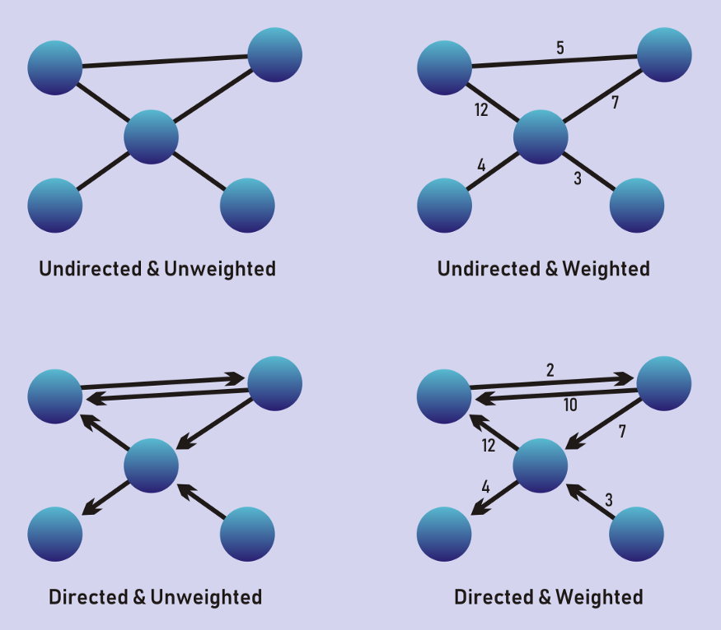
Types of Graph
Notes:
Source: https://medium.com/tebs-lab/types-of-graphs-7f3891303ea8

Slide 11
Some Real Life Uses of Graph

Slide 12
Social Media Representation
Example 1: Users and their followers on Twitter can be represented using a graph. Such a graph will be a directed graph. Similarly, the users on facebook and their friends can also be represented using a graph. Such a graph will be an unidirected graph.

Slide 13
Maps
Examples 2: A city map can be modeled by a graph whose vertices are intersections or dead ends, and whose edges are stretches of streets without intersections. This graph has both undirected edges, which correspond to stretches of twoway streets, and directed edges, which correspond to stretches of one-way streets. Thus, in this way, a graph modeling a city map is a mixed graph.

Slide 14
Implementation of Graphs
Graphs can be implemented using two approaches:
Adjacency Matrix
Adjacency List

Slide 15
Adjacency Matrix
If there are n nodes, then create an n*n array. It will be square matrix.
The elements of the matrix indicate whether pairs of vertices are adjacent or not in the graph.

Slide 16
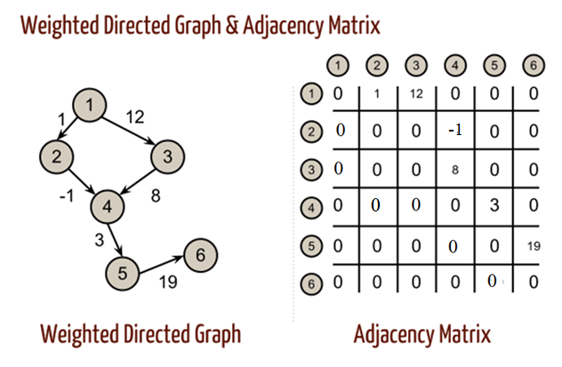
Adjacency Matrix for Weighted Directed Graph

Slide 17
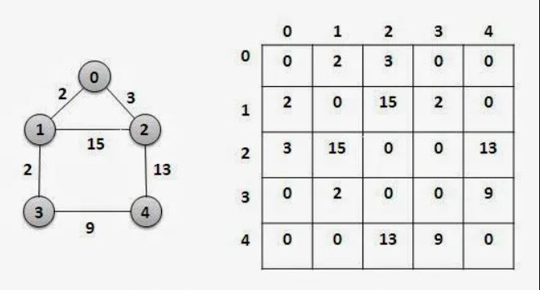
Adjacency Matrix for Weighted Undirected Graph

Slide 18
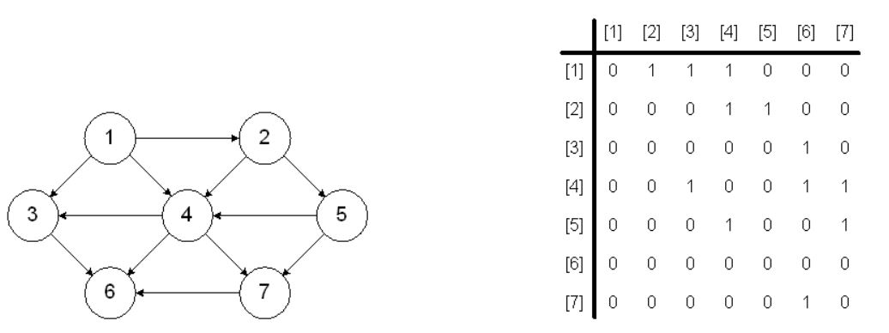
Adjacency Matrix for Unweighted Directed Graph

Slide 19
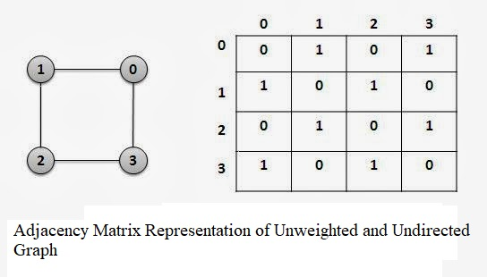
Adjacency Matrix for Unweighted Undirected Graph

Slide 20
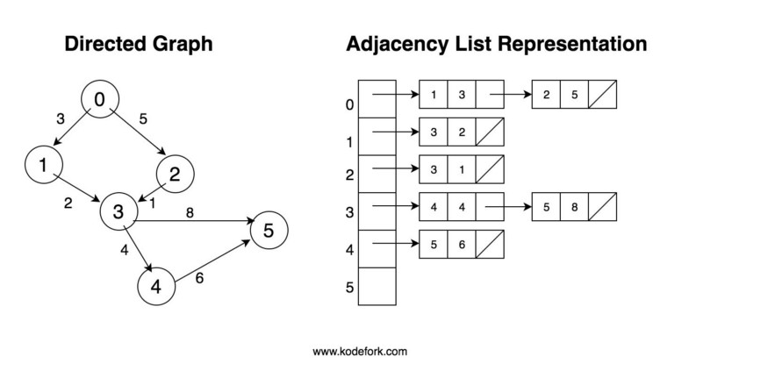
Adjacency List for Weighted Directed Graph

Slide 21


Space Complexity
Adjacency Matrix:
, where V is the set of vertices and |V| is the count of vertices. Space complexity is the same for directed and undirected graphs when implemented using adjacency matrix.
Adjacency List:
For Directed Graphs:
where E is the set of edges, and|E| is the count of edges.
For Undirected Graphs:

Slide 22
Tree vs Graph
Tree | Graph
A tree is acyclic. | Graph may be cyclic or acyclic.
A tree is connected. | A graph may or may not be connected.
There exists exactly one path between two nodes. | There can be single, multiple, or no path between two nodes.
A tree is undirected. | A graph may be directed or undirected.
There is one and only one root node in a tree. | There is no root node in a graph.
A tree structure forms a hierarchy. | A graph structure forms a network.
All trees are graphs. | All graphs are not trees.

